Slide 1

USAFA ASTRO
2026 Fall
Lab #8
KestrelSAT Capstone
Agentic AI Workflow
Getting started with Coding Agents
ASTRO 331 – Space Systems Engineering
Notes:
This brief expands the Method slide from the Lab 8 guidance: how to go from a lab folder to agent-written, cadet-verified code on KestrelSAT.

Slide 2
Prerequisites
2026 Fall
Complete before your first agent session:
Overview
GitHub account
One per cadet. Verify student status at education.github.com for free Copilot access.
Example
1 Repo
2 Session
GitHub Desktop
Install and sign in with your GitHub account (GitHub Desktop is proffered for this class, but other Git utilities are fine).
3 Connect
4 Commits
5 Adjudicate
VS Code + PlatformIO
Already installed from earlier labs. Confirm a lab project still builds.
Pitfalls
GenAI Docs
Teams
Coding agent account
Claude Pro, or a free option (Codex, Copilot Student). See Agent Tool Options.
KestrelSAT GCS
Installed, with KestrelSAT, USB cable, and XBee radio on hand for testing.
Astro 331 Lab #8
2
Notes:
Complete before the first agent session. GitHub account and Desktop sign-in are the common blockers; GitHub Education verification can take a few days.

Slide 3
Method (Review)
2026 Fall
SPECIFY
GENERATE
IMPLEMENT
ADJUDICATE
Overview
Verifiable requirements
Agent proposes a design
Trusted tool(s) make it real
Engineer owns the call
Example
1 Repo
2 Session
ITERATE
3 Connect
4 Commits
The general workflow for agentic coding is:
5 Adjudicate
1
Pitfalls
Create repo for your project and push it to GitHub
GenAI Docs
2
Open a new session in Claude Code/ChatGPT Codex/other coding agent
Teams
3
Connect your repo to the session
4
Work with the agent to generate commits for your project
5
Adjudicate agent work and iterate!
Astro 331 Lab #8
3
Notes:
Recap of slide 5 of the Lab 8 guidance. The loop is the mindset; the five steps are the mechanics. Every remaining slide maps to one of the five steps.

Slide 4
Git Basics (Review)
2026 Fall
Local repo
push
Remote repo
Overview
your laptop (Git)
fetch / pull
GitHub (origin)
Example
1 Repo
Term
Meaning
GitHub Desktop
2 Session
3 Connect
Repository (repo)
A project folder whose full history Git tracks
Add / Clone repository
4 Commits
Commit
A saved snapshot of changes, with a message
Commit to <branch>
5 Adjudicate
Pitfalls
Push
Send your commits to GitHub
Push origin
GenAI Docs
Fetch / Pull
Check for / download commits from GitHub
Fetch origin / Pull origin
Teams
Branch
A separate line of commits; main is the default
Current branch menu
Diff
Line-by-line changes: + added, − removed
Changes tab / History tab
Pull request (PR)
A request on GitHub to merge one branch into another, with review comments
Create Pull Request (opens GitHub)
A coding agent uses these same operations: it commits to its own branch and pushes to GitHub. You fetch that branch to test it.
Astro 331 Lab #8
4
Notes:
Review only. Git runs on the laptop; GitHub hosts the shared copy. The agent uses the same operations: it commits to a branch and pushes to GitHub, and cadets fetch that branch to test it.

Slide 5
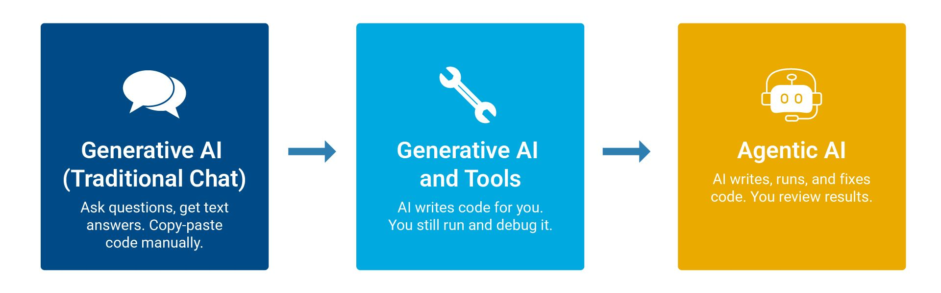
Chat LLM vs. Coding Agent
2026 Fall
Overview
Example
1 Repo
2 Session
Chat LLM (copy/paste)
Coding agent (e.g. Claude Code)
3 Connect
4 Commits
Sees your code
Only what you paste in
Reads the whole repo itself
5 Adjudicate
Pitfalls
Edits code
You copy, paste, and merge by hand
Edits files and commits them to a branch
GenAI Docs
Teams
Runs commands
No
Yes, in a cloud sandbox (search, scripts, compile)
Project rules
Re-explained in every chat
Written once in CLAUDE.md, read every session
Your role
Integrator and debugger
Specifier, reviewer, and tester
An agent does more work per prompt. Each prompt needs a clearer specification, and each result needs a closer review.
Astro 331 Lab #8
5
Notes:
Most cadets have only used chat LLMs. The key shift: the agent works directly in the repo, so the cadet's job moves from integrating code to specifying and verifying it.

Slide 6
Agent Tool Options
2026 Fall
Tool
Where it runs
Free access
Context file
Overview
Claude Code on the web (this ppt’s example)
Cloud sandbox, working from your GitHub repo
No. Pro plan or higher
CLAUDE.md
Example
1 Repo
2 Session
3 Connect
OpenAI Codex
Your laptop (app, CLI, VS Code extension); cloud tasks on paid plans
Yes, with a ChatGPT Free account: small allowance, local tasks only
AGENTS.md
4 Commits
5 Adjudicate
Pitfalls
GitHub Copilot agent mode
VS Code on your laptop; cloud agent on GitHub
Yes, for verified students (Copilot Student), credit-limited
.github/ copilot- instructions.md
GenAI Docs
Teams
The five workflow steps are the same for every tool.
With a local agent, Steps 2–3 become “open the repo folder in VS Code.” The agent edits your working copy; you review and commit in GitHub Desktop.
Plans and limits change often. Check each tool’s current plan page.
Astro 331 Lab #8
6
Notes:
Claude Code on the web is the worked example, but the workflow applies to any coding agent. Codex (local tasks) and GitHub Copilot (verified students) have free access with usage limits. Plans change often; check current plan pages before committing a team to one tool.

Slide 7
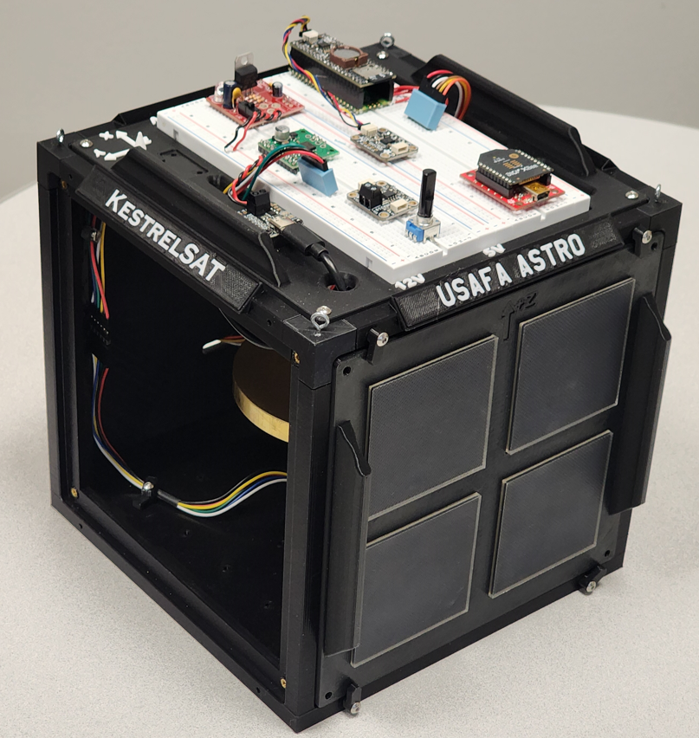
Example: Ground Command 10
2026 Fall
SPECIFY
STARTING POINT
Overview
Astro331_Lab7_Code. process_main_menu() already handles commands 0–9, 98, and 99.
Example
1 Repo
2 Session
REQUIREMENT
3 Connect
KestrelSAT shall respond to ground command 10 with one telemetry line containing battery voltage, state of charge, gyro Z, mag X, and mag Y, formatted for the GCS plotter.
4 Commits
5 Adjudicate
Pitfalls
GenAI Docs
Teams
V:3.912,SOC:84.2,gZ:0.12,mX:-21.40,mY:14.75
VERIFICATION
Demonstration: send 10 from the GCS over XBee. The reply arrives on one line and the GCS plots all five channels.
Astro 331 Lab #8
7
Notes:
One small feature carried through every step. Command numbers 0-9, 98, 99 are already used in the Lab 7 code, so the example uses 10. The requirement is written to be verifiable before any code exists.

Slide 8
Step 1: Create & Push Repo
2026 Fall
SETUP
Overview
1
Download the course repo. Copy the contents of Astro331_Lab7_Code into a new folder.
KestrelSAT-Capstone/
├─ platformio.ini
├─ include/
│ ├─ definitions.h
│ └─ sd_functions.h
├─ src/
│ ├─ main.cpp
│ └─ sd_funcitons.cpp
├─ lib/INA238-master/
├─ .gitignore
└─ CLAUDE.md
← Step 1b
Example
1 Repo
2
GitHub Desktop: File › Add local repository › select the folder › create a repository.
2 Session
3 Connect
4 Commits
3
Commit to main: “Initial copy of Lab 7 code.”
5 Adjudicate
4
Publish repository to GitHub (keep it private).
Pitfalls
GenAI Docs
5
Open the folder in VS Code and run PlatformIO Build once, before any changes.
Teams
Lab folder at the repo root, so PlatformIO opens it directly.
Astro 331 Lab #8
8
Notes:
Seed the repo with one lab folder at the root so PlatformIO opens it directly. Build once before any changes: a clean baseline means later build errors came from new code.

Slide 9
Step 1b: Add CLAUDE.md
2026 Fall
SETUP
Claude Code reads CLAUDE.md at the start of every session.
Overview
# KestrelSAT Capstone (Team 3)
## About us
- New to Arduino and C++. Explain each
change in plain terms before coding.
- Prefer simple code over clever code.
## Hardware - SparkFun Thing Plus ESP32
PlatformIO env: esp32thing_plus
- XBee: HardwareSerial(2), 9600 baud
- ICM-20948 IMU, MAX17048 gauge (I2C)
- Pin map: include/definitions.h
## Conventions - Commands: process_main_menu()
- Telemetry: Name:value,Name:value\n
- Mirror every XBee message to Serial
## Rules - Never change pins without asking
- Add libraries only via lib_deps
- No blocking waits in loop()
- You can't test on hardware: list
what I must verify on KestrelSAT
Example
1 Repo
Include what a new teammate would need: hardware, where the pin map lives, conventions, rules.
2 Session
3 Connect
4 Commits
Start with /init : the agent scans the repo and drafts the file. Then correct and add the hardware facts it can’t see.
5 Adjudicate
Pitfalls
GenAI Docs
Teams
Keep it short. Add a rule each time the agent repeats a mistake.
Codex: /init writes AGENTS.md.
Copilot: Generate Chat Instructions writes .github/copilot-instructions.md.
Astro 331 Lab #8
9
Notes:
CLAUDE.md is the most effective single thing a team can do to improve agent output. It is plain Markdown committed to the repo root. The About us section tells the agent the team is new to Arduino, so it explains its changes and keeps code simple. Cadets can also ask in any prompt: explain this like I've only done three Arduino labs. Codex reads AGENTS.md the same way.

Slide 10
Step 2: Open a Session
2026 Fall
SETUP
Overview
Claude Code
GitHub repo
Your laptop
KestrelSAT
Example
cloud sandbox
shared source
Desktop + PlatformIO
USB
1 Repo
2 Session
3 Connect
The session can read and change your repo. It cannot reach your laptop, its USB ports, or KestrelSAT.
4 Commits
5 Adjudicate
ONE-TIME SETUP
Pitfalls
1
Go to claude.ai/code and sign in.
GenAI Docs
Teams
2
Claude Code requires a paid plan (Pro or higher). For free options, see Agent Tool Options.
3
Connect GitHub when prompted. Install the Claude GitHub App on your capstone repo only.
4
Accept the Default environment (Trusted network access).
Astro 331 Lab #8
10
Notes:
Emphasize the architecture: the agent never touches the hardware. GitHub is the hand-off point between the cloud session and the cadet's laptop. Note: Claude Code is not included in the Free plan; at least one teammate needs Pro.

Slide 11
Step 3: Connect Repo
2026 Fall
SETUP
1
New session: select your capstone repo and the main branch.
Overview
Example
2
The session clones the repo and loads CLAUDE.md.
1 Repo
3
Send an orientation prompt before asking for any change:
2 Session
3 Connect
4 Commits
YOU
5 Adjudicate
Read CLAUDE.md and src/main.cpp. Summarize how ground commands are handled and list the command numbers already in use. Don’t change any files.
Pitfalls
GenAI Docs
Teams
AGENT
Commands arrive over XBee or USB Serial and are dispatched by a switch in process_main_menu(). Codes in use: 0–9, 98, 99. Case 1 prints the help menu. Replies go to XBee and are mirrored to Serial.
Check the summary against the code. If the agent misunderstands the code now, its changes will be wrong too.
Astro 331 Lab #8
11
Notes:
The orientation prompt costs one message and tells you whether the agent understands the code. In this example it confirms command 10 is free. If the summary is wrong, fix CLAUDE.md before going further.

Slide 12
Step 4: Plan Before Code
2026 Fall
GENERATE
Overview
YOU
AGENT
Example
Add ground command 10 that replies with one telemetry line:
Plan (src/main.cpp only):
1 Repo
1. Add prototype send_state_telemetry().
2 Session
V:<volts>,SOC:<pct>,gZ:<dps>, mX:<uT>,mY:<uT>
2. Add case 10 to process_main_menu().
3 Connect
3. New function: call getAGMT(), read voltage, SOC, gyrZ, magX, magY; send one line to Xbee and Serial.
4 Commits
Send it over XBee and mirror it to Serial. Add it to the help menu. Use the existing lipo and imu_sensor objects; no new libraries.
5 Adjudicate
Pitfalls
4. Add “10 - State telemetry” to the case 1 menu.
GenAI Docs
Don’t write code yet. Give me a plan: files and functions you’ll change, and any questions.
Teams
Question: should gZ use the same units and sign as lab6_run_test()?
YOU
Plan approved. Match lab6_run_test(). Implement it and commit.
Check the plan for: expected files only · real library functions · questions answered by you, not guessed.
Astro 331 Lab #8
12
Notes:
Asking for a plan first is cheap and catches wrong assumptions before code is written. Good plans name files, functions, and open questions. The cadet answers the questions; the agent should not guess.

Slide 13
Step 4: Review the Commit
2026 Fall
GENERATE
Overview
claude/ground-cmd-10 · src/main.cpp +17 −0
Green + lines were added; red − lines were removed.
Example
@@ process_main_menu(), case 1 @@
1 Repo
Xbee.print("9 - Stream RW speed\n");
+ Xbee.print("10 - State telemetry\n");
Read every line. You will be asked to explain it.
2 Session
@@ process_main_menu() @@
3 Connect
case 9: stream_RWspeed(); break;
4 Commits
+ case 10:
Ask about anything unclear: “Why call getAGMT() first?”
+ send_state_telemetry();
5 Adjudicate
+ break;
Pitfalls
@@ new function @@
Select Create PR in the session. The team reviews the PR before merging.
GenAI Docs
+void send_state_telemetry() {
Teams
+ imu_sensor.getAGMT();
+ String s = "V:" + String(lipo.getVoltage(), 3)
+ + ",SOC:" + String(lipo.getSOC(), 1)
+ + ",gZ:" + String(imu_sensor.gyrZ(), 2)
+ + ",mX:" + String(imu_sensor.magX(), 2)
+ + ",mY:" + String(imu_sensor.magY(), 2);
+ Xbee.println(s);
+ Serial.println(s);
+}
Astro 331 Lab #8
13
Notes:
The agent pushes to a new claude/ branch, never directly to main. Walk through the diff line by line. Cadets must be able to explain every line they submit.

Slide 14
Step 4: Branches & PRs
2026 Fall
GENERATE
Overview
claude/ground-cmd-10
Example
Add command 10
Fix zero gZ
1 Repo
a1b2c3d
e4f5a6b
PR #3: review, test, then merge
2 Session
3 Connect
main
4 Commits
5 Adjudicate
Initial copy
Merge PR #3
main
main
Pitfalls
GenAI Docs
Branch
Pull request (PR)
Teams
A separate line of commits. main is unchanged until the branch is merged.
A request on GitHub to merge a branch into main. It shows the diff, the commits, and a comment thread.
Each session creates its own branch (claude/…) and pushes every commit there, including fixes.
1
Select Create PR in the session.
GitHub Desktop’s Current branch menu switches your local copy between main and the agent’s branch.
2
Teammates comment on specific lines.
3
Test the branch on KestrelSAT (Step 5).
4
Merge only after it passes.
Astro 331 Lab #8
14
Notes:
The agent never commits to main. Each session gets its own branch, and every commit in that session, including fixes, goes there. The pull request is where the team reviews the change and where it gets merged after the hardware test passes.

Slide 15
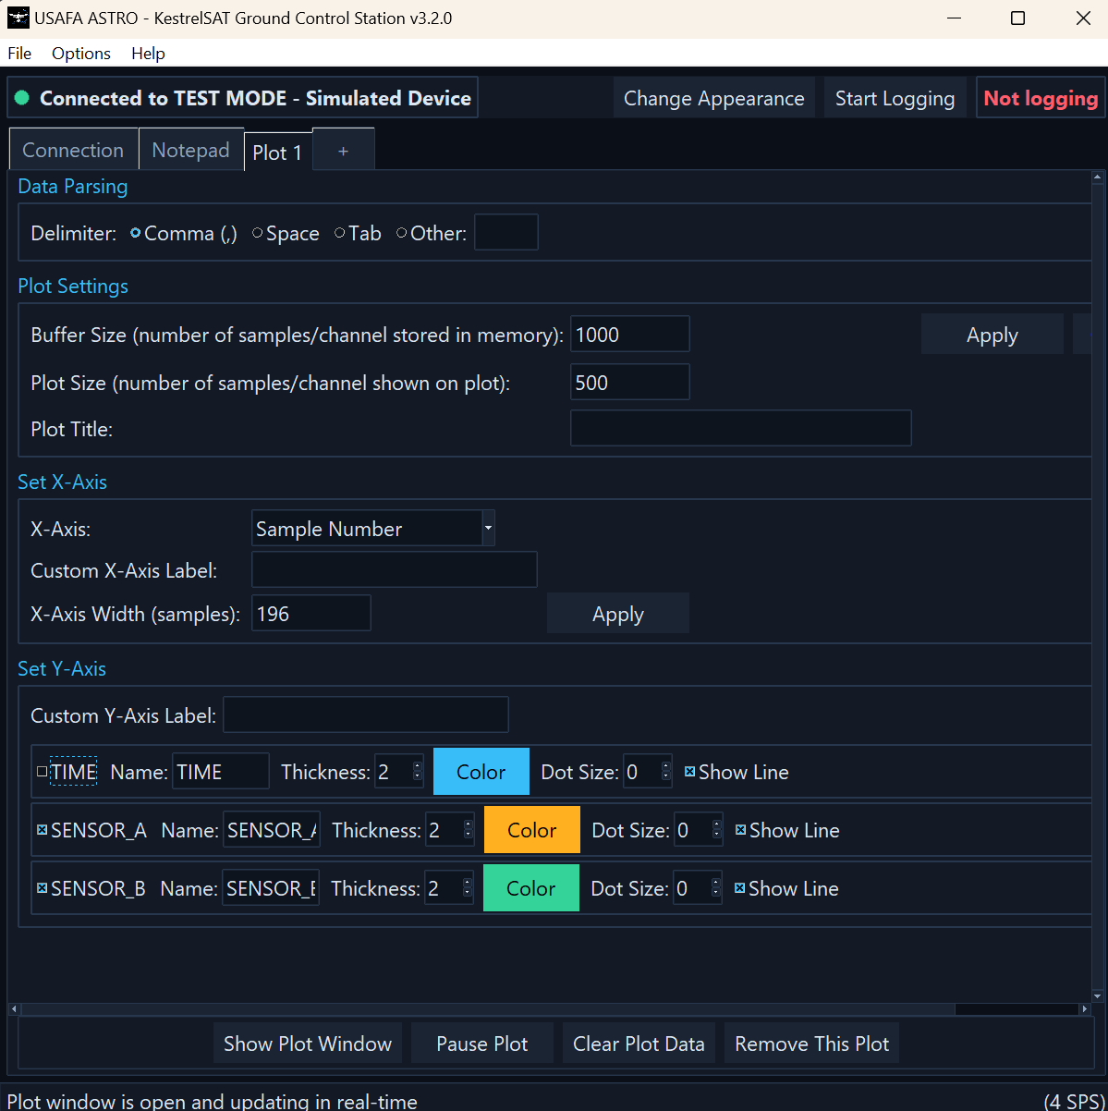
Step 5: Test on Hardware
2026 Fall
IMPLEMENT
ADJUDICATE
Overview
1
GitHub Desktop: Fetch origin, then switch Current branch to claude/ground-cmd-10.
Example
1 Repo
2
PlatformIO: Build, then Upload to KestrelSAT over USB.
2 Session
3 Connect
3
KestrelSAT GCS: connect to the XBee port, send 10, open the plot window.
4 Commits
5 Adjudicate
Pitfalls
GenAI Docs
Teams
PASS CRITERIA (FROM THE REQUIREMENT)
One line per command, with all five values: V:3.912,SOC:84.2,gZ:0.12,mX:-21.40,mY:14.75
Values are plausible: V 3.0–4.2, SOC 0–100, gZ ≈ 0 at rest.
Rotate KestrelSAT: gZ, mX, and mY respond in the GCS plot.
Astro 331 Lab #8
15
Notes:
This is the only step that tests the requirement. Compiler, PlatformIO upload, and the GCS are the trusted tools. Until KestrelSAT confirms the behavior, the agent's commit is a proposal.

Slide 16
Step 5: Iterate & Merge
2026 Fall
ADJUDICATE
ITERATE
If it fails
If it passes
Overview
Example
Report what you observed and paste the output.
1
Merge the PR on GitHub.
1 Repo
2
GitHub Desktop: switch to main, Pull origin.
2 Session
3 Connect
YOU
3
Start a new session for the next requirement.
4 Commits
On hardware, command 10 returns V and SOC correctly, but gZ, mX, and mY are always 0.00. Serial output below. Find the cause and explain it before changing code.
5 Adjudicate
4
Add a rule to CLAUDE.md for any mistake the agent made twice.
Pitfalls
GenAI Docs
[paste Serial output]
Teams
The agent pushes a new commit to the same branch. Fetch, build, upload, retest.
Astro 331 Lab #8
16
Notes:
Failure reports should contain observations and logs, not just 'it doesn't work'. One requirement per session keeps context small and commits easy to review.

Slide 17
Common Failure Modes
2026 Fall
Failure
KestrelSAT example
How you catch it
Overview
Invented function
imu_sensor.getGyroZ() (the library provides gyrZ())
Build error; check the library header
Example
1 Repo
2 Session
Invented library
lib_deps entry that isn’t in the PlatformIO registry
Search it in PlatformIO Libraries
3 Connect
4 Commits
5 Adjudicate
Pin conflict
New sensor on pin 14, already ENCODER_PIN_A
Compare against definitions.h
Pitfalls
Blocking code
while (!Xbee.available()) inside loop()
Heartbeat stops in the GCS
GenAI Docs
Teams
Scope creep
Unrequested “cleanup” of other functions
Diff touches lines you didn’t expect
Unverified claim
“Tested and working”
The agent can’t reach KestrelSAT; you test
Astro 331 Lab #8
17
Notes:
Every row here has happened with embedded code. Agents produce plausible code that may reference functions or libraries that do not exist. The build, the pin map, and the hardware are the checks.

Slide 18
Documenting GenAI Use
2026 Fall
“This use of GenAI must be clearly documented as instructed, specifying how GenAI contributed and what the cadet did to revise or evaluate that content.”
Overview
Example
GenAI Level 4, Lab 8 Guidance
1 Repo
Keep an AI_LOG.md in the repo, with one entry per session:
2 Session
3 Connect
## 2026-10-14 · Ground command 10 Session: claude.ai/code link
Driver: Cadet A Reviewers: Cadets B, C
Prompts: orientation, plan, implement, fix zero gZ
Agent made: commits a1b2c3d, e4f5a6b (PR #3)
We changed: gZ convention (matched lab6_run_test)
Verified: GCS plot of all 5 channels, rotation test
Issue found: gZ, mX, mY read 0.00 on first upload
4 Commits
5 Adjudicate
Pitfalls
GenAI Docs
Teams
The commit history and PR discussion are also part of the record.
Astro 331 Lab #8
18
Notes:
Level 4 requires documenting how GenAI contributed and what cadets did to evaluate it. An AI_LOG.md in the repo, one entry per session, meets that requirement and becomes part of the graded repo.

Slide 19
Working as a Team
2026 Fall
An agent session belongs to one account, and teammates can’t join it. The GitHub repo is the team’s shared workspace.
Overview
Example
1 Repo
OPTION A
OPTION B
2 Session
One driver
Parallel drivers
3 Connect
One teammate with agent access runs the sessions.
Each teammate runs sessions on their own requirement and branch. Tools can differ.
4 Commits
5 Adjudicate
Pitfalls
The others review plans and PRs, and test on hardware.
Merge through PRs.
GenAI Docs
Don’t have two sessions editing the same function.
Teams
Rotate the driver for each requirement.
Either way: add every teammate as a collaborator on the repo (Settings › Collaborators). Never share agent account login credentials.
Astro 331 Lab #8
19
Notes:
A Claude Code session belongs to one account; teammates cannot join it live. The repo is where collaboration happens. Do not share Claude login credentials.

